Slide 1
eConsent 2.0 Setup Guide
12/10/2024

Slide 2
eConsent 2.0 Features
New eConsent Features can be found directly on Designer page instead of Survey Settings
Multi-signature functionality
Versioning of PDF Consent Forms
Auto-archiving of signed Consent Forms

Slide 3
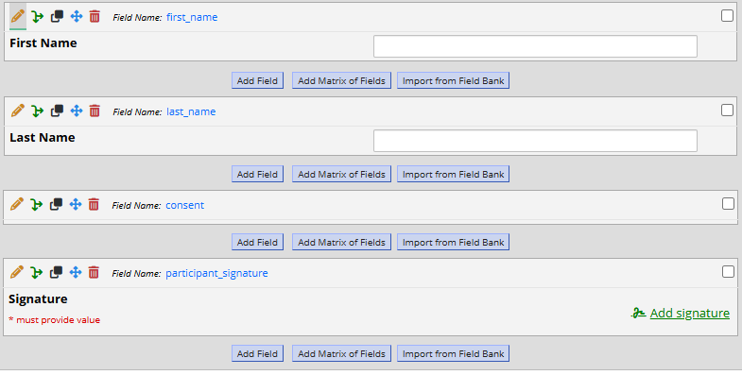
eConsent Requirements
Electronic Consent Instrument must be enabled as a Survey
EC Instrument must contain a First Name, Last Name, Consent, and Signature Field
Signature Field must be required
Consent Field is set to Descriptive Text Field Type and left blank

Slide 4
Setting Up eConsent Part 1
Click on eConsent and PDF Snapshots button on Designer page
Click ‘Enable the eConsent Framework for a survey’
Select the Electronic Consent form that was previously set up
Map the First Name, Last Name and Signature Fields to the form settings

Slide 5
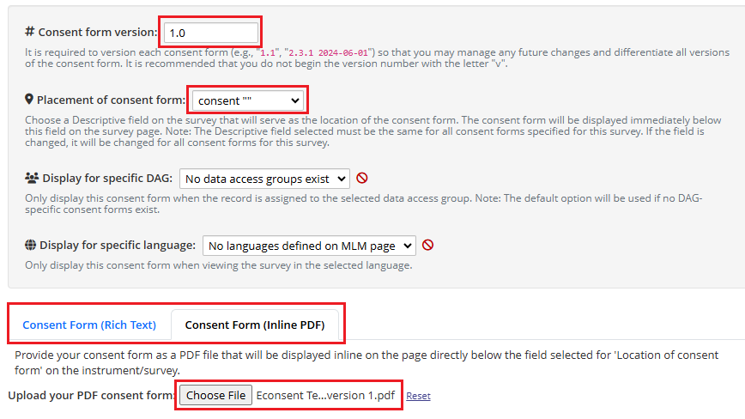
Setting Up eConsent Part 2
Click ‘+ Add consent form’
Set the Consent form version to 1.0
Choose the ‘consent’ descriptive text field for placement of consent form
To have the Consent text display in REDCap, choose Consent Form (Rich Text) to type out the text
Choose Inline PDF if you want to upload a file to display on the form

Slide 6
Versioning of Consent Forms
If you later need to update the consent form, navigate to eConsent settings and click ‘+ Add consent form’
Set the new version number to ‘2.0’, etc.
Upload the new file or type out the new consent form text under Inline PDF or Rich Text
Participants filling out eConsent will have their version numbers tracked

Slide 7
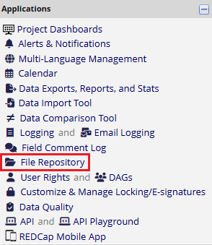
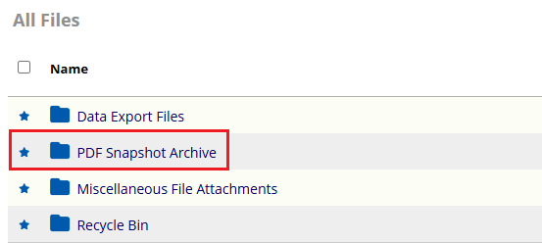
eConsent File Storage
Navigate to File Repository under Applications in the REDCap Project
Click on PDF Snapshot Archive
All signed Consent Forms will display here with version number, record number, and name of participant

